Slide 1
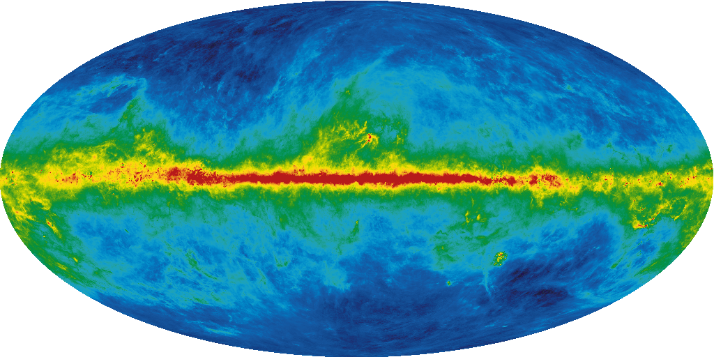
Dark Matter and Cosmology
Astroparticle Physics
Part 6 – WS 2019
Federico Ambrogi

Slide 2
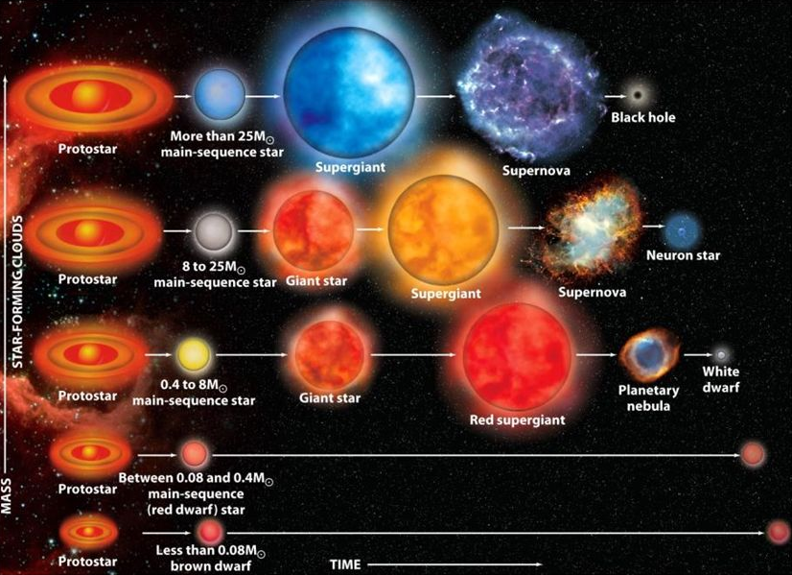
Stellar Evolution (i.e. Where BHs and NSs come from)
Star evolution mostly depends on the mass of the original gas cloud
Metallicity i.e. chemical composition impacts fusion processes
For initial mass Mi > 0.08 M○ -> white dwarfs
For Mi > 8 M○ -> Supernova (SN) explosion and NS remnant
For Mi > 8 M○ -> SN explosion and formation of BHs (fallback or direct)
Stellar evolution end with the creation of White Dwarfs, SNe, Neutron Satrs, Black Holes which are sources of gravitationl waves!
[ Typical numbers of neutron star:
Mass ~ 1.4 M○
radius ~ 10 Km
magnetic field 10¹² Gauss (LHC: 4 T = 40k Gauss, average in Milky way ~ microGauss, Earth surface~0.2 Gauss) ]
Notes:
2
2

Slide 3
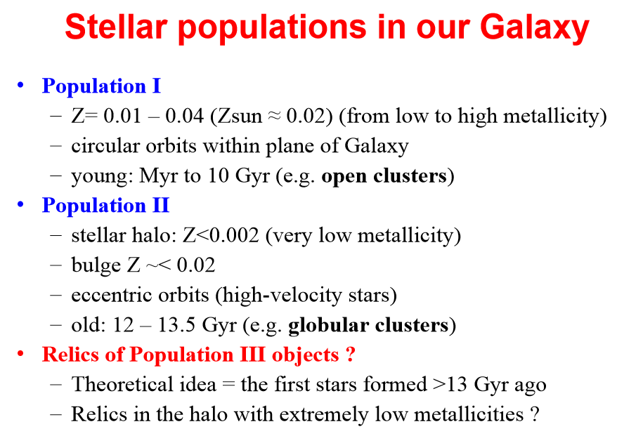
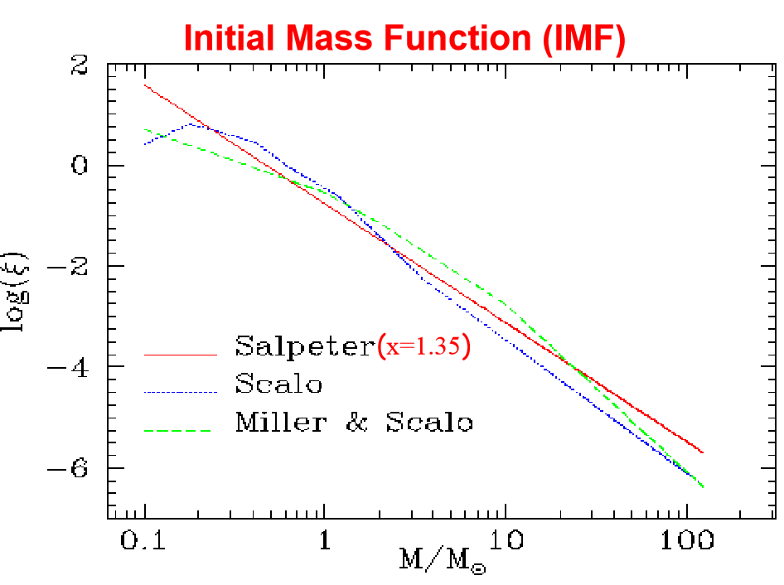
Stellar Initial Mass Function

Slide 4
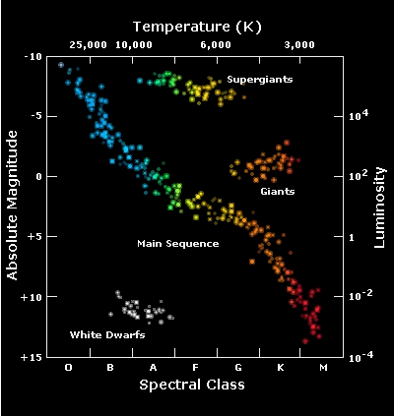
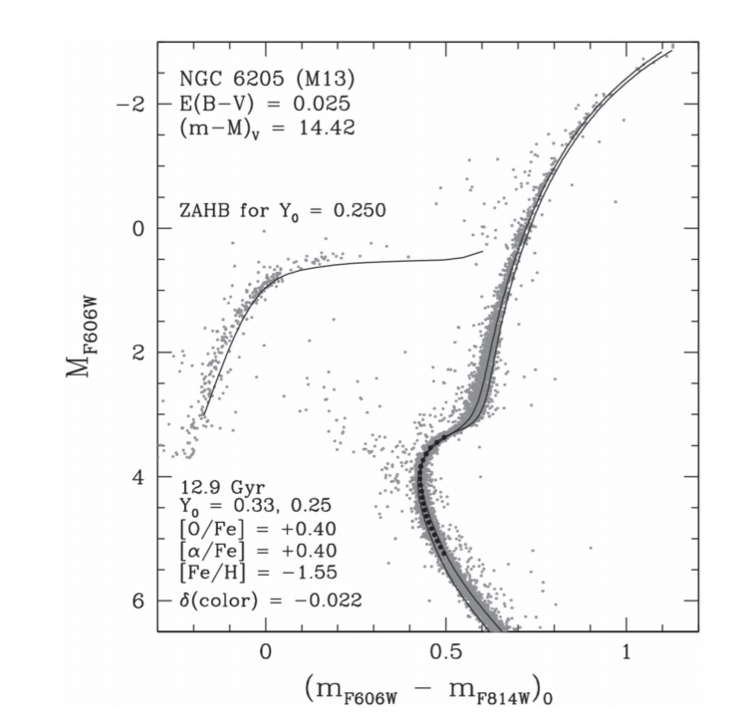
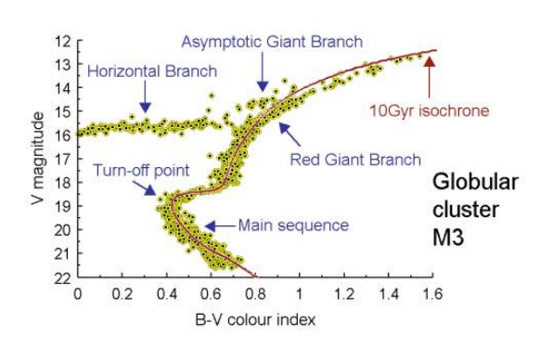
Stellar Evolution (i.e. Where BHs and NSs come from)
Isochrone: curve on the HR diagram representing a population of stars of ~ same age (like e.g. globular clusters)
By fitting the stellar population with a model isochrone, it is possible to estimate the population age
Each feature (e.g. turning points, branches,…) of the isochrone can be explained by models of stellar evolution (type/size/region of nuclear fusion processes)
hotter
colder
Notes:
4
4

Slide 5
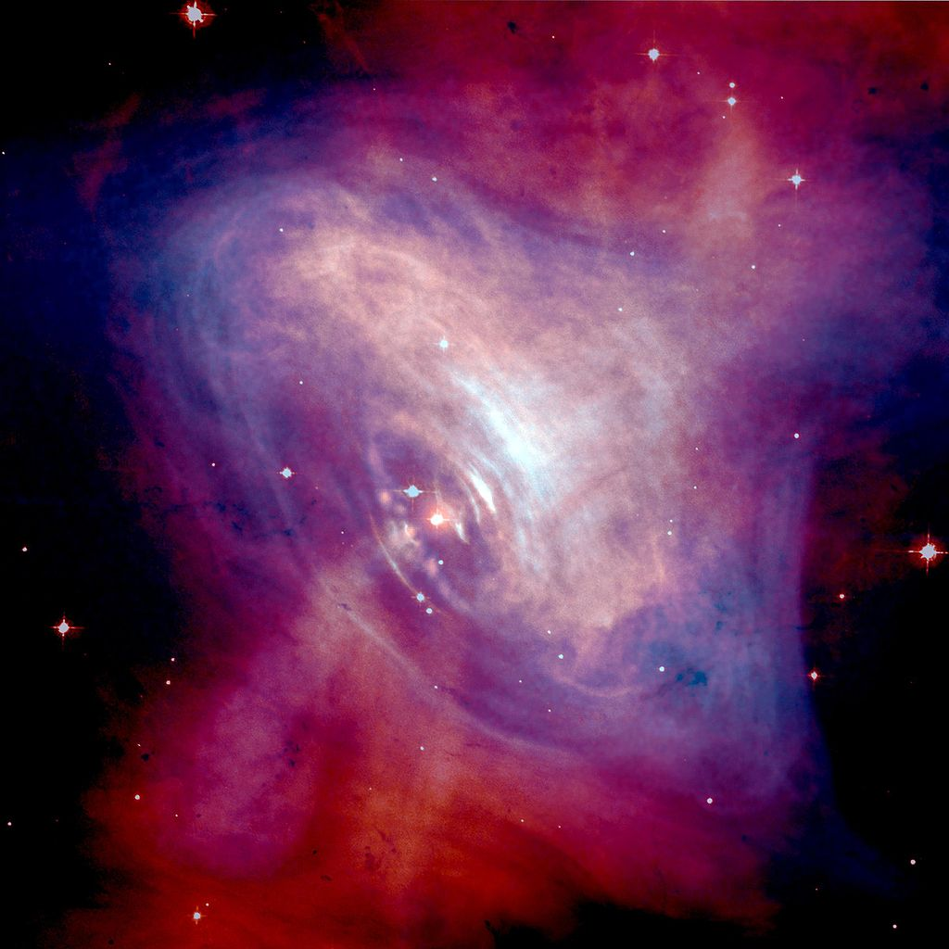
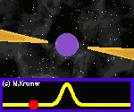
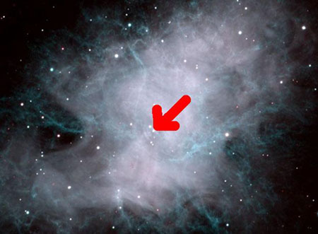
Pulsars
http://www.jb.man.ac.uk/distance/frontiers/pulsars/section1.html
Pulsars (Pulsating Radio Source) are rapidly spinning neutron stars
Their rotation period span from the order of milliseconds to the order of ~8 seconds
Pulse: collection of radio waves of different frequencies
Rotation period extremely stable, although the rotation speed slows down with time
„Lighthouse“ effect
Composite optical/X-ray image of the Crab Nebula, showing synchrotron emission in the surrounding pulsar wind nebula, powered by injection of magnetic fields and particles from the central pulsar.
Optical image of the Crab nebula (NOAO).
The arrow marks the position of the pulsar.
Notes:
5
5

Slide 6
Introduction
In this lecture we will see the role of Dark Matter in the evolution of the universe and in the formation of cosmic structure
Cosmology is a discipline that studies the origin and evolution of the universe
It is a very fascinating theory, yet very complicated
It is based on Einstein‘s theory of general relativity (GR)
The most favoured and largely accepted model of Cosmology is called ΛCDM
How, when did the universe form?
How did it evolve?
What is the geometry of the universe? And what is the energy content?
How did structures (from the first stars to galaxies) form?
What is the CMB? Why is it so homogeneous
In temperature?
How will the universe „end“ ?

Slide 7
Cosmology: building blocks
The ﬁrst and most important feature of the universe aka the ”Cosmological Principle” (CP) : at suﬃciently large scales, is homogeneous and isotropic
It was introduced to make Einstein’s ﬁelds equation of General Relativity solvable in particular simple situations, e.g. systems with spherical symmetry. It was ﬁnally observed that the principle holds eﬀectively on scales larger than about 300 Mpc, well beyond typical the scale of formed structures in the universe (galaxy superclusters, the largest structures in the present universe, reach dimensions of a few tens of Mpc)
At smaller and smaller scales the universe is very inhomogeneous, with large portions of void between formed structures (planets, stars, galaxies, clusters …)
The best evidence for isotropy is the Cosmic Microwave Background Radiation (CMB), the relic of the initial phase of the universe (the so called ”Big Bang”) originated at the decoupling of matter and radiation. It is found at exactly the same average temperature of ∼ 2.73 K in any direction we observe it, with fluctuations < 10-5 K.

Slide 8
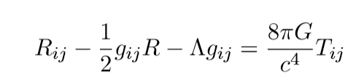
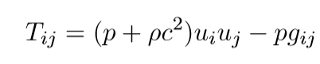
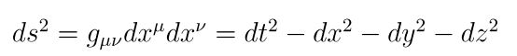
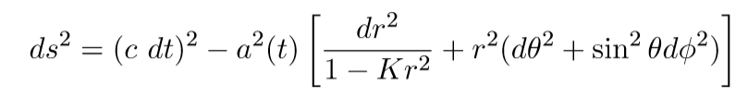
Cosmology: building blocks
Thanks to the CP, we can apply Einstein’s theory of gravitation in a much simpler form
In particular we can look at the universe as a continuous, homogeneous and isotropic ﬂuid. For such system, the most general metric of the space-time, called Robertson-Friedmann-Walker, for an expanding universe takes the form
Ricci Tensor
Energy Tensor
Metric tensor
Cosmological Constant
Pressure, mass energy,
4-velocity tensors
the invariant interval between two events at coordinates (t,x,y,z) and (t+dt,x+dx,y+dy,z+dz)

Slide 9
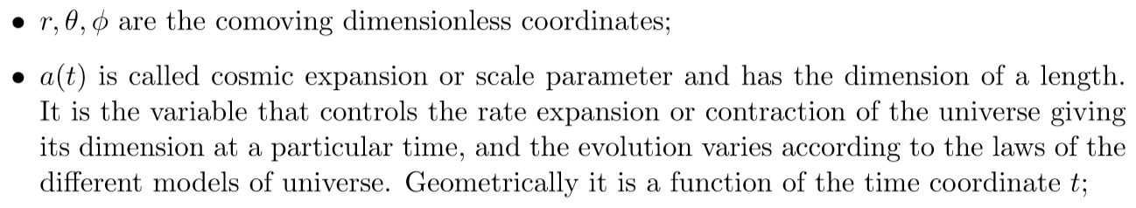
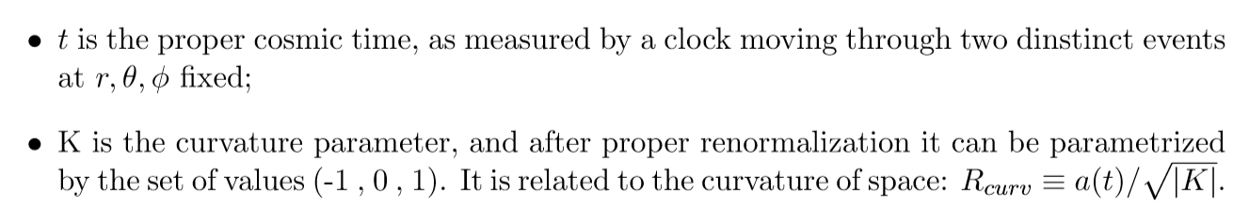
Robertson-Friedmann-Walker Metric

Slide 10
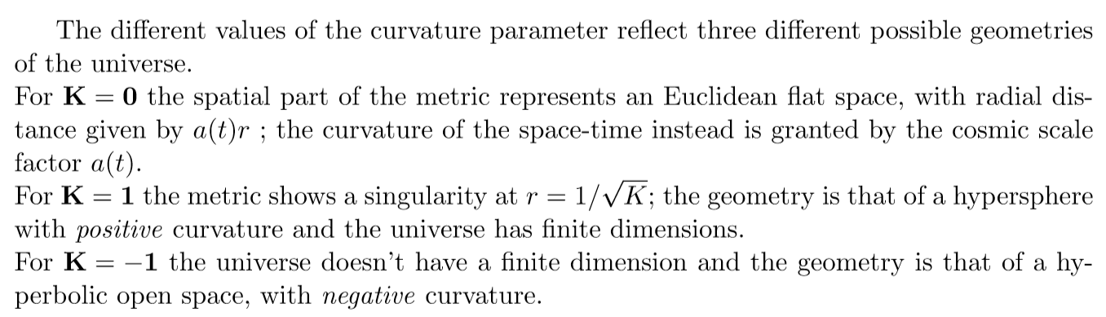
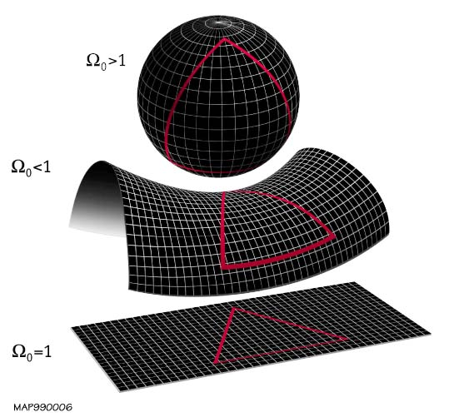
Geometry of the Universe

Slide 11
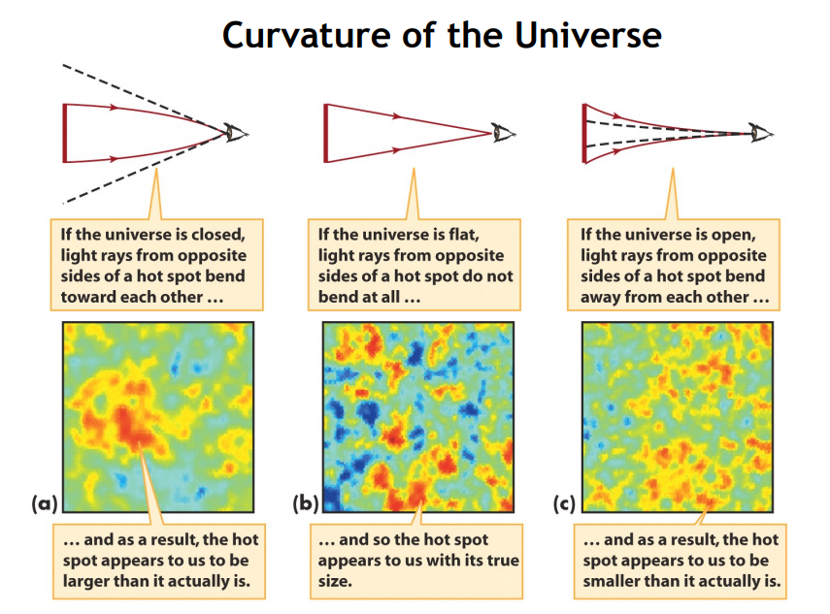
Geometry of the Universe
Depending on the geometry, the dimension of distant object changes according to the angle formed by the light

Slide 12
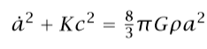
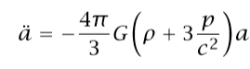
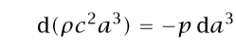
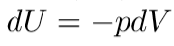
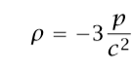
Friedman’s Solutions
The two solutions are not independent, but can be retrieved by considering the adiabatic condition:
Such kind of Universe cannot be static, unless the pressure assumes a negative value:
This lead Einstein to introduce the Cosmological Constant Λ

Slide 13
Friedman’s Solutions
The two solutions are not independent, but can be retrieved by considering the adiabatic condition:
“ With an appropriate choice of Λ, one can obtain a static cosmological model. Equation … represents the most general possible modiﬁcation of the Einstein equations that still satisﬁes the condition that Tij is equal to a tensor constructed from the metric gij and its ﬁrst and second derivatives, and is linear in the second derivative. The strongest constraint one can place on Λ from observations is that it should be suﬃciently small so as not to change the laws of planetary motion (from Cosmology by Coles-Lucchin)“

Slide 14
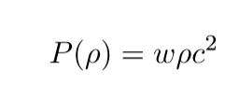
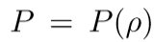
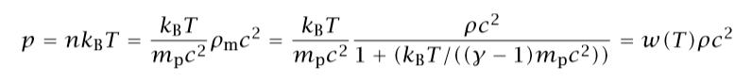
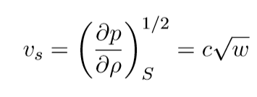
Some Useful Formulas
Equation of state
Each component of the cosmic fluis is treated separately, with a proper eqution of state ,
Which relates the pressure of the component to its density, e.g.
Example: Ideal gas of nonrelativistic particles of mass , temperature T, density and adiabatic index γ
It is also possible to calculate the adiabatic sound speed of the fluid:
Since it canot exceed the speed of light, w must be necessarily < 1

Slide 15
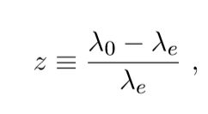
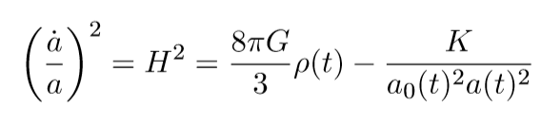
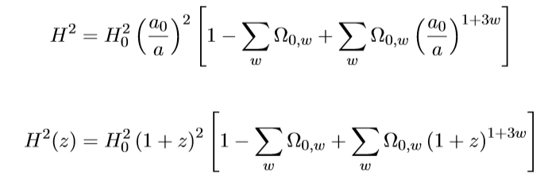
Some Useful Formulas
Redshift z : given a source emitting light, the redshift is calculated as the shift between the observed and emitted wave length (at source), divided by the wavelength at source

Slide 16
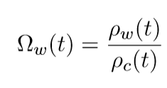
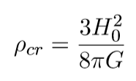
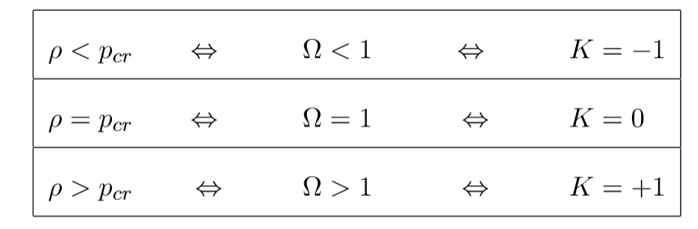
Evoution of the Components of the Universe
Density of each component of the Universe
Critical density ( esitmaed: 1-3x10⁻²⁹ g/m³)
Currently, the most favoured geometry of the Universe is the „flat“ case
i.e. the total energy density of all components equals the critical density

Slide 17
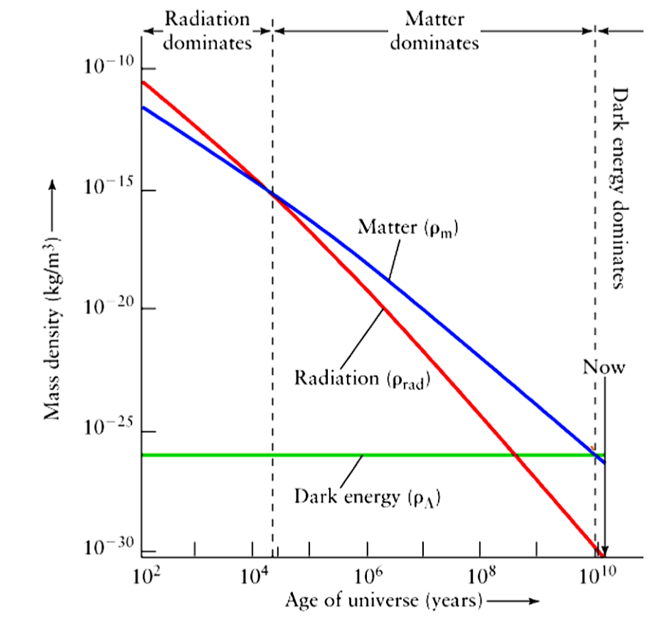
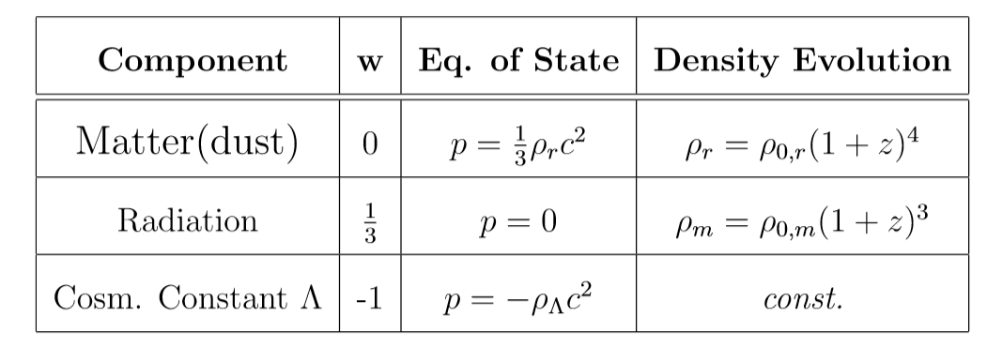
Evoution of the Components of the Universe
Combining the adiabaticity condition and the equation of state, for specific values of w:

Slide 18
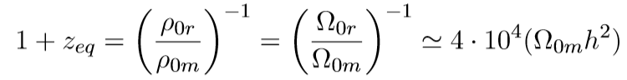
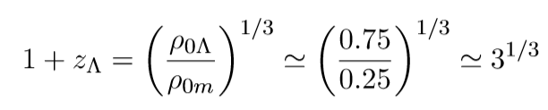
Evoution of the Components of the Universe
Combining the adiabaticity condition and the equation of state, for specific values of w:
Matter-radiation equivalence
“Matter-Lambda” equivalence

Slide 19
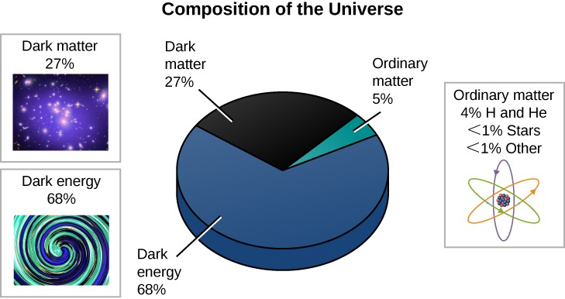
Evoution of the Components of the Universe
Matter-radiation equivalence
Radiation (photons and relativistic particles such as neutrinos) does not contribute significantly anymore to the energy budget of the universe

Slide 20
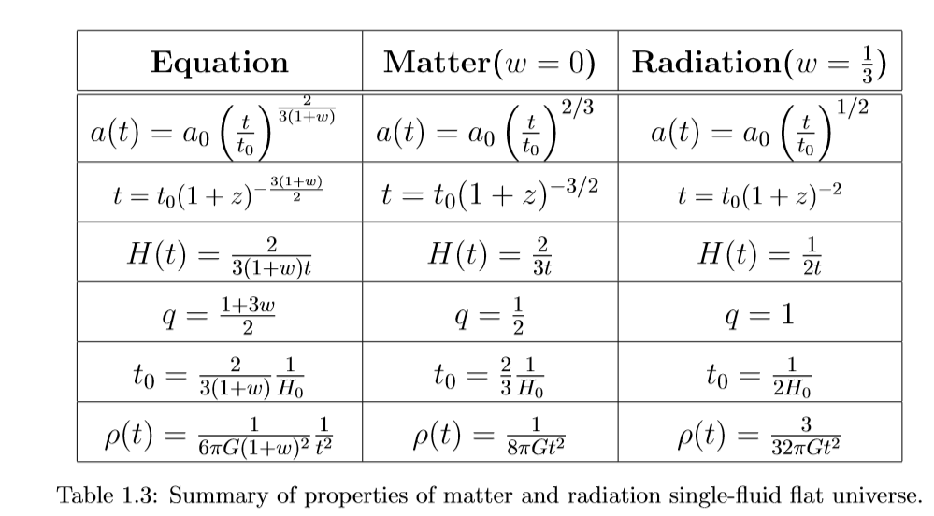
Evoution of the Components of the Universe
Example: equations for a flat universe (k=1) composed of a single fluid (matter or radiation)

Slide 21
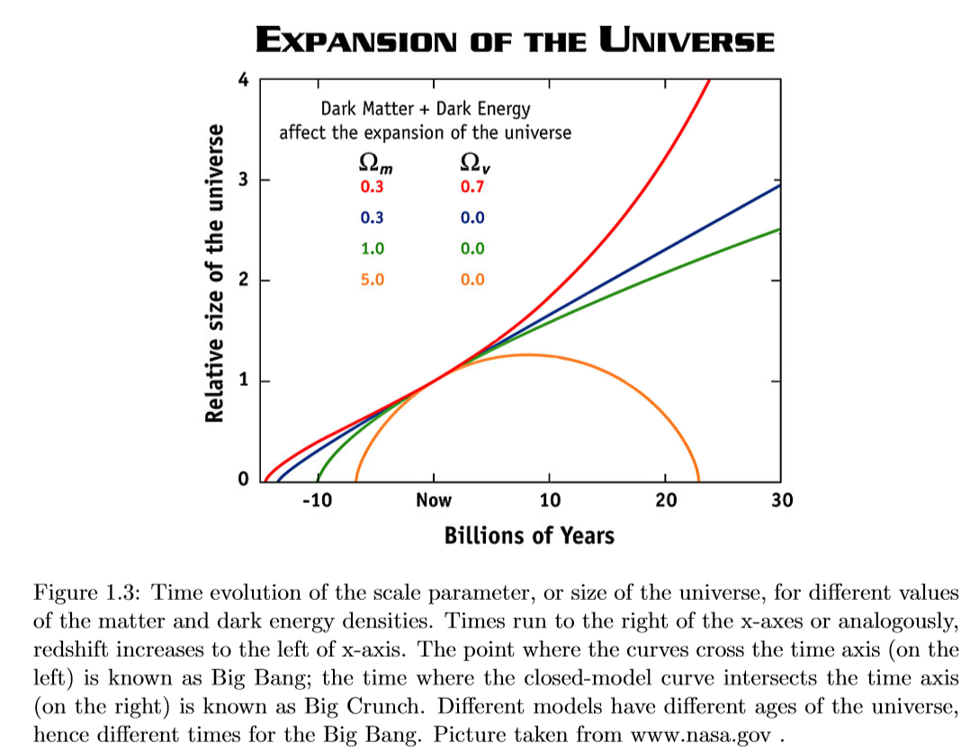
Fate of the Universe ?
Depending on the geometry and on the energy content of the universe (divided into its different components), the fate of the universe will be different
We are in a situation “now” which is compatible with most models
Big-Bang
Big-Crunch

Slide 22
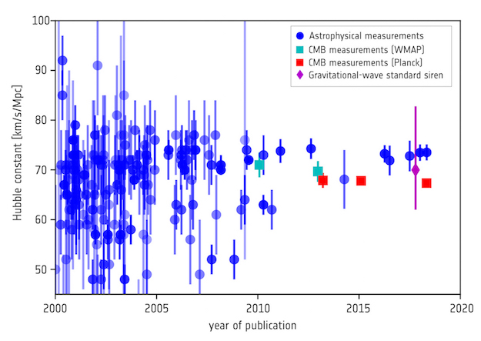
The Hubble Parameter
«Alternatively, the Hubble Constant can also be estimated from the cosmological model that fits observations of the cosmic microwave background, which represents the very young Universe, and calculate a prediction for what the Hubble Constant should be today. Measurements based on this method using data from NASA's WMAP satellite are shown in green, and those obtained using data from ESA's Planck mission are shown in red. On the one hand, it is extraordinary that two such radically different ways of deriving the Hubble constant – one using the local, mature Universe, and one based on the distant, infant Universe – are so close to each other. On the other hand, in principle these two figures should agree to within their respective uncertainties, causing what cosmologists call a 'tension' – an oddity that still needs explaining.»
https://sci.esa.int/web/planck/-/60504-measurements-of-the-hubble-constant

Slide 23
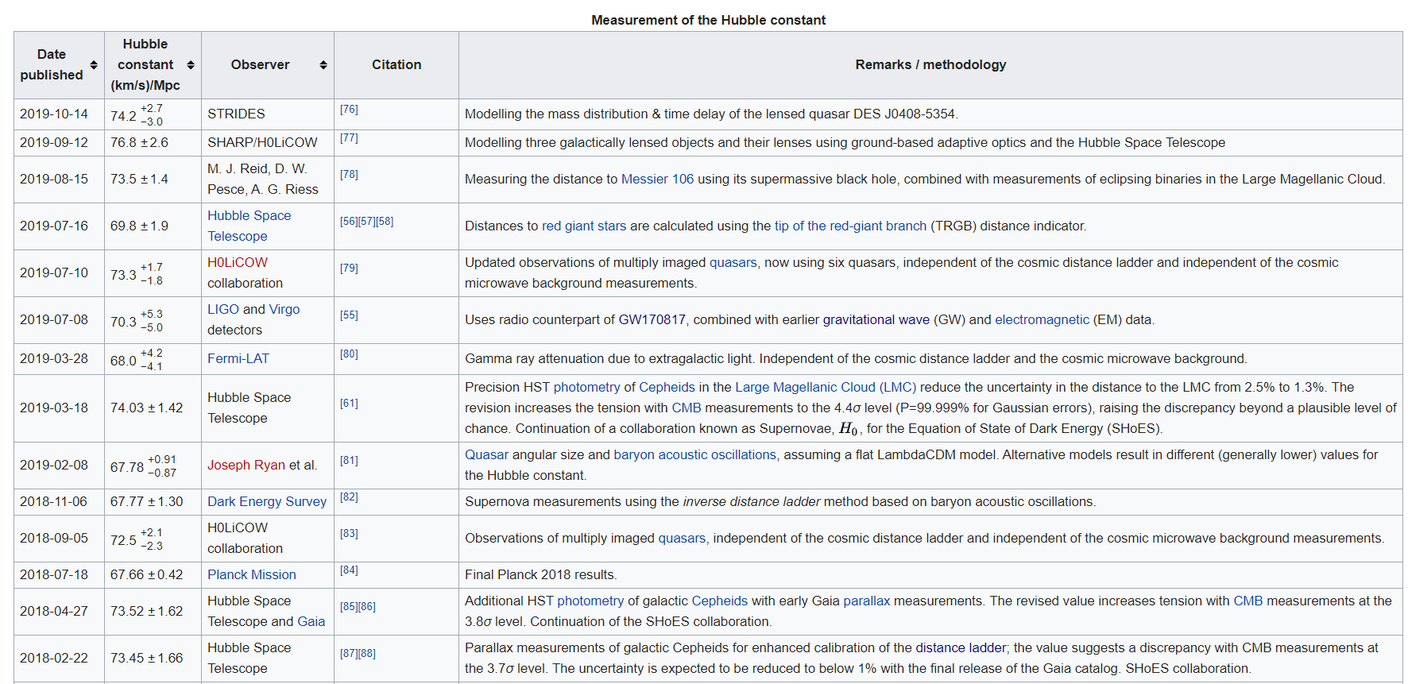
The Hubble Parameter

Slide 24
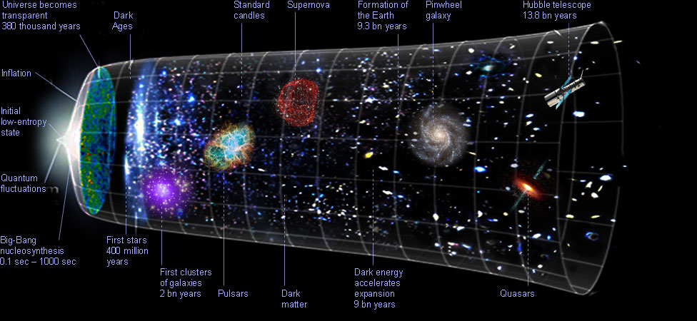
History of the Universe

Slide 25
History of the Universe
Summary of fundamental steps in the evolution of the Universe:
Big bang
Quantum fluctuations and local DM overdensities
Inflation
Baryogenesis and Nucleosynthesis
Release of the CMB from the last scatter surface
Recombination
Dark ages
First stars (Population III)
Reionization
First galaxies, first quasars
(...)
Very complex problem
Need to take into account particle physics (which particle are present in each epoch? Are they relativistic? Are they in thermal equilibrium? Were there more particles than today (e.g. „X“ boson that unifies the 4 forces – electromagnetic, weak, strong gravitational ? Quantum gravity?
What causes inflation? How and when it ended?
Why the CMB is so isotropic and uniform? Cosmic neutrino background?
Why baryogenesis? Leptogenesis?
What is DM? How does it drive structure formation?
???
How to investigate all of these questions?

Slide 26
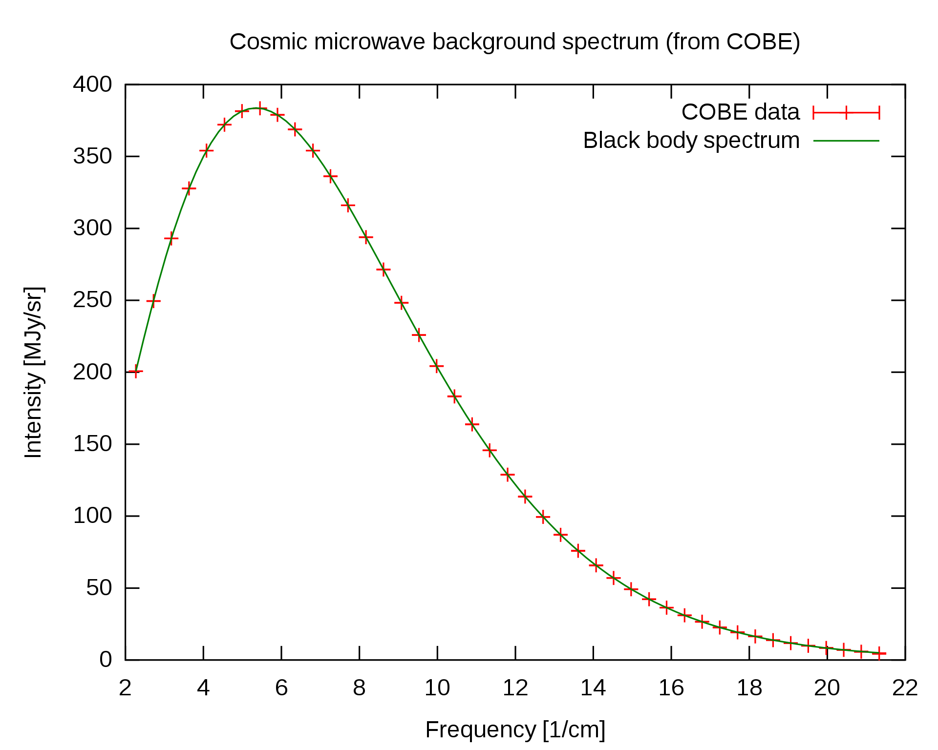
The Cosmic Microwave Background
The cosmic microwave background radiation is an emission of uniform, black body spectrum coming from all parts of the sky
It is a consequence of recombination, i.e. the moment in the history of the Universe when charged electrons and protons form electrically neutral hydrogen atoms (at a redshift of z = 1100)
Photons and charged particles were electrically coupled, and the Thomson scattering would prevent photons to free stream
Today Energy density: ~ 0.25 eV/cm³ , 400–500 photons/cm³
Temperature evolution with redshift:
Graph of cosmic microwave background spectrum measured by the FIRAS instrument on the COBE, the most precisely measured black body spectrum in nature. The error bars are too small to be seen even in an enlarged image, and it is impossible to distinguish the observed data from the theoretical curve.
T_{r} = 2.725 ⋅ (1 + z)

Slide 27
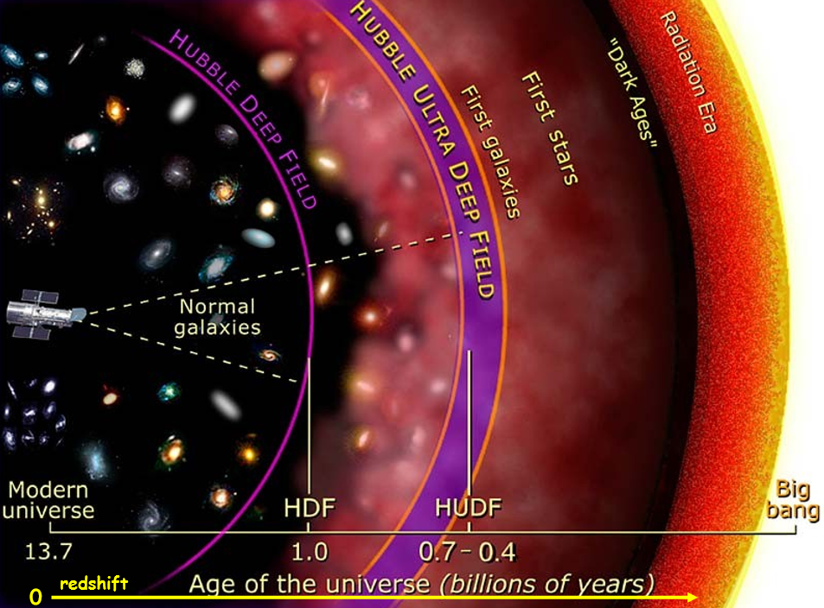
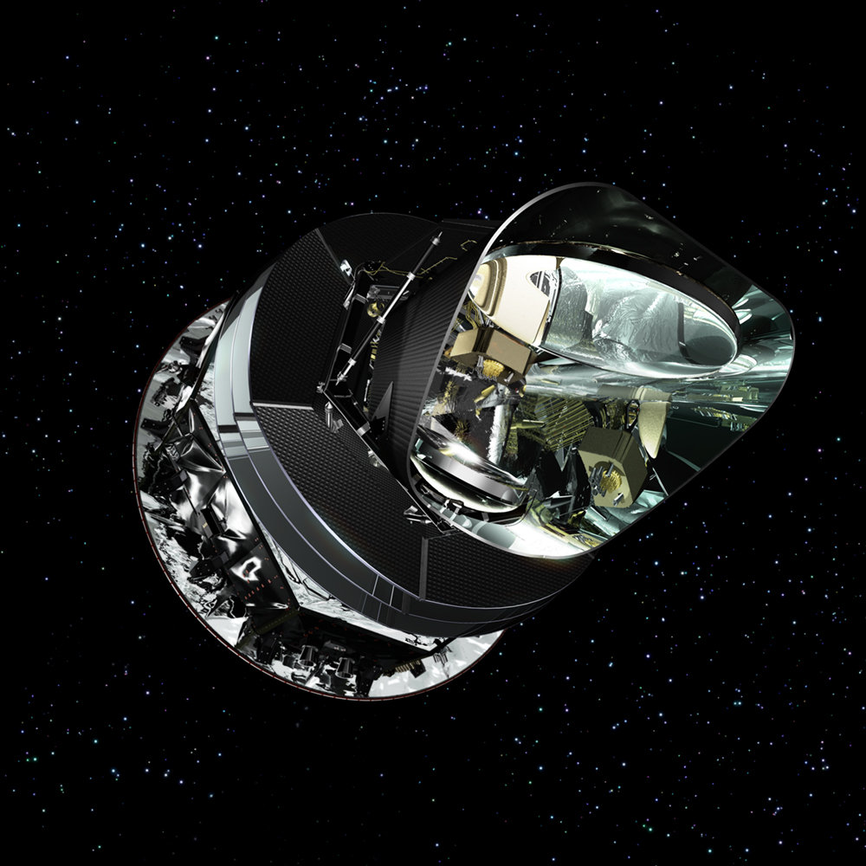
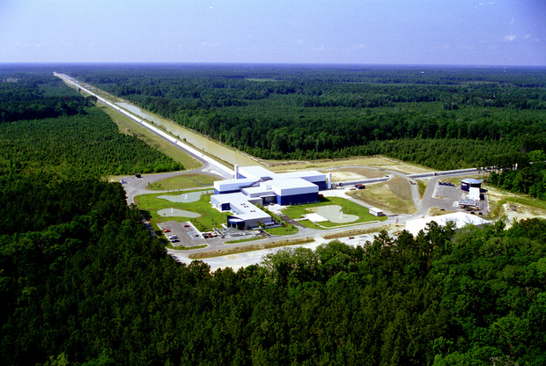
Planck - CMB
Gravitational Waves?

Slide 28
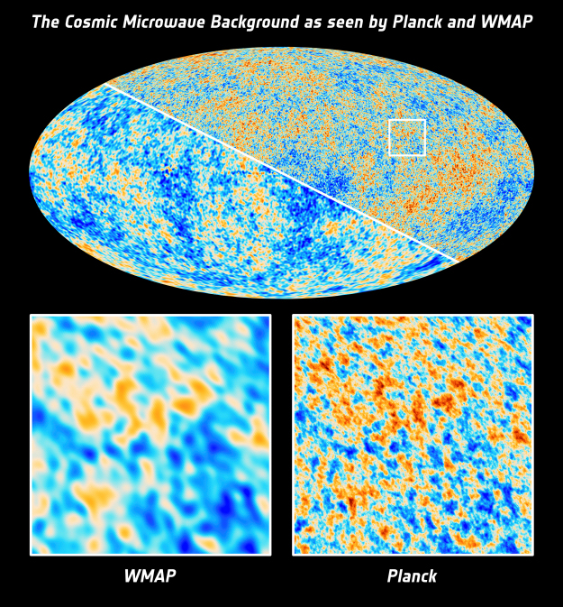
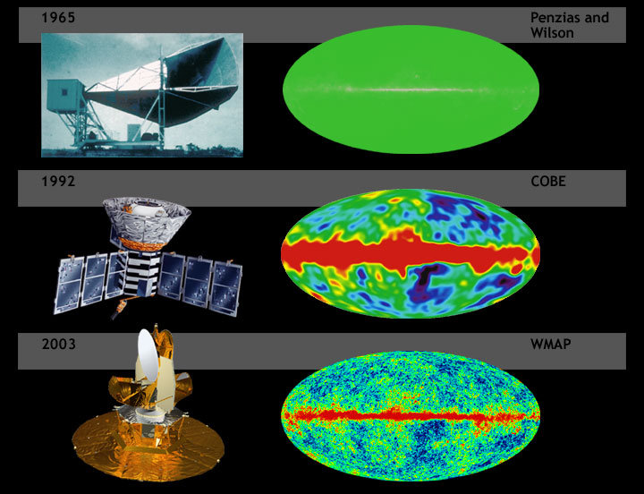
The Cosmic Microwave Background

Slide 29


The Cosmic Microwave Background
The most serious anomaly is a deficit in the signal observed on scales around 5 degrees, which is about ten per cent weaker than predicted. Other anomalous traits are a significant discrepancy of the signal as observed in the two opposite hemispheres of the sky (the two hemispheres are outlined by the large, roughly u-shaped curve in the image, the northern one being at the centre) and a so-called 'cold spot' – a large, low-temperature spot with an unusually steep temperature profile (also outlined in the lower right).
Planck’s anomalous sky: the hemispheric asymmetry and the cold spot. Credit: ESA and the Planck Collaboration

Slide 30


The Cosmic Microwave Background
Planck 2018: https://arxiv.org/pdf/1907.12875.pdf
The CMB is sensitive to the DM content
arXiv:1903.03026
Residual vs CDM model
Residual vs 2015 data

Slide 31


Big-Bang Nucleosynthesis
Nuchleosynthesis is the fundamental process through which elemens were created right after the Big-bang
It explains the very homogeneous distribution of ~light elements (H, He, Li) found in the universe
“Metals” in Astronomy : elements other than H and He
The element which is typically tracked is Iron (Fe), since it is assumed that the relative abundance of the other elements (e.g. C, N, Ca…) is proportional
Metallicity = [Fe/H] : how many Fe atoms are present per H atoms
X+Y+Z = 1
X⊙ ~ 0.7
Y⊙ ~ 0.28
Z ⊙ ~ 0.02
Solar values

Slide 32

Big-Bang Nucleosynthesis

Slide 33

Big-Bang Nucleosynthesis
“By the first millisecond, the universe had cooled to a few trillion kelvins (10¹² K) and quarks finally had the opportunity to bind together into free protons and neutrons. Free neutrons are unstable with a half-life of about ten minutes (614.8 s) and formed in much smaller numbers. The abundance ratio was about seven protons for every neutron. Before one neutron half-life passed nearly every neutron had paired up with a proton, and nearly every one of these pairs had paired up to form helium. By this time the universe had cooled to a few billion kelvins (10⁹ K) and the rate of nucleosynthesis had slowed down significantly.
By the time the universe was three minutes old the process had basically stopped and the relative abundances of the elements was fixed at ratios that didn't change for a very long time: 75% hydrogen, 25% helium, with trace amounts of deuterium (hydrogen-2), helium-3, and lithium-7.
Big Bang nucleosynthesis produced no elements heavier than lithium. To do that you need stars, which means waiting around for at least 200 billion years”
https://physics.info/nucleosynthesis/

Slide 34





Big-Bang Nucleosynthesis
Weak interaction: maintain the thermal equilibrium between neutrons and protons (Boltzman distribution)
(…calculations…)
It can be shown that the predicted fraction of Helium produced is Y ~ 0.25
All the other isotopes and elements are below %

Slide 35

Big-Bang Nucleosynthesis
Solar values
X⊙ ~ 0.7
Y⊙ ~ 0.28
Z ⊙ ~ 0.02

Slide 36

Structure Formation: the Cold DM paradigm
CDM = Cold Dark Matter
HDM = Hot Dark Matter
Properties of particle DM in the
DM particles interact gravitationally in the ΛCDM
(however DM particles might interact via weak interaction or other unknown interactions – “dark sector” )
This means that they cannot dissipate energy via electromagnetic processes i.e. DM is dissipationless
DM can only convert energy: kinetic <-> potential

Slide 37


Structure Formation: the Cold DM paradigm
Take home message:
There is a parameter (or there are parameters) which regulate the gravitational collapse of DM (or matter in general)

Slide 38



Structure Formation: the Cold DM paradigm
HDM - hot DM, if dark matter particles are still relativistic at time of decoupling
CDM - cold DM, if dark matter particles are no more relativistic at time of their decoupling
For neutrinos, the free streaming mass depends on the mass of this particle. If > 0.2 eV, it exceeds the mass of the largest supercluster ever observed.
So: what is the typical size of galaxies that we observe as a function of the redshift, or what is the typical size of DM halos that we get from simulations, for different types of cosmological models?

Slide 39

Structure Formation: the Cold DM paradigm
Paradigm:
The collapses of baryonic matter (that constitute the galaxies and clusters) follow the gravitational collapse of the DM halos
The physics of baryonic matter is much more complicated than the physics of DM (collisionless, dissipationless)
Perturbations in baryonic matter follow those of DM after decoupling
After ecombination, baryons fall inot DM potential wells
Entering the DM halo at superosnic speed, the baryonic gas is heated by the shock waves and compressions to the virial temperature of the halo
The virial radius of the baryonic content of a structure an become much smaller than that of the DM halo because baryons can cool by radiative procsses and contract further

Slide 40




Distributions of Dark Matter Halos
Press-Schechter theory (1974)
Method to estimate the number of DM halos, with a given mass, at a given redshift
Assumptions:
The DM over-densities follow a random Gaussian profile
The over-densities grow linearly with time
The DM particles collapse spherically (spherical Halos)
Number of DM halos at time t with mass between M and M+dM

Slide 41

Distributions of Dark Matter Halos
PS = Press-Schechter
ST = Sheth-Tormen
“For now, in our simulations we consider only the most dominant matter component, responsible for the overall dynamics - the dark matter. We examined "concordance" cosmology (n=1, h=0.7, 25.2% dark matter, 70% dark energy, baryons 4.8%), and we run 62 simulations with different box sizes (from 4 Mpc on a side to 256 Mpc), and with numerous number of realizations for each box size. The fact we have simulations spanning from small regions of the universe (4³ Mpc³) up to a reasonably big ones (256³ Mpc³) enables us to probe very large range of masses and redshifts, and since we have a lot of statistical samples for each box size, we have excellent statistics. We have compared mass function starting at very high redshift (z=20) with analytical predictions and numerical fits, and our finding is that Warren et al. (2005) fit works the best over the whole redshift and mass range.”
https://www.uio.no/studier/emner/matnat/astro/AST4320/h12/undervisningsmateriale/psmassfunction.pdf
http://zarija.com/s_structure_formation.html

Slide 42

Distributions of Dark Matter Halos
DM Halo mass function
Galactic mass function

Slide 43



Galaxy Formation: top-down vs bottom-up
Depending on the size of the initial DM halos (and on the Jean’s mass), the cosmic structures might have two possible evolution scenarios
Top-Down Structure Formation
In a top-down scenario, vey large „pancakes“ of matter form. Eventually they will fragment and divide into smaller galaxies and structures
Bottom-Up Structure Formation
In a bottom-up scenario, galaxies of the size of dwarf galaxies (5 Mo) form. Larger scale structure will then form through events of merging
HDM
CDM

Slide 44



Matching Observations and Simulations
Las Campanas Redshift survey
HDM and the top-down scenario predict smooth, weak features in the large scale distribution of galaxies
CDM and the bottom-up scenario instead predict sharp features with weak connecting filaments

Slide 45






Matching Observations and Simulations
Redshift z=0 (t = 13.6 Gyr)
Redshift z=18.3 (t = 0.21 Gyr)
https://wwwmpa.mpa-garching.mpg.de/galform/virgo/millennium/

Slide 46

Galaxy Formation
Very complex due to the feedback produced by stars (supernovae, black holes, eventually AGNs…)

Slide 47


The Future: ESA EUCLID
Euclid: visible to near-infrared space telescope
The launch date is planned for June 2022

